Slide 1

Capstone 2:
Classifying Twitter Text
Predicting whether a student or teacher tweeted using NLP Machine Learning Techniques
Christos Magganas - Springboard

Slide 2
NLP Classification Prediction
Objective: Twitter Classification – gather twitter data from two similar groups of users with a clear identifiable keyword in their profile, specifically “Students” and “Teachers.” Then create an Natural Language Processing prediction model that attempts to identify them based on tweet text.

Slide 3
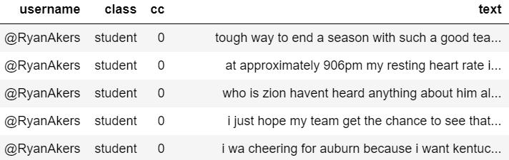
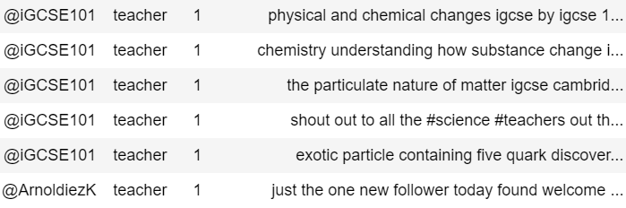
DATA SCRAPING / WRANGLING / CLEANING
Here we see some examples of the tweets after they have been cleaned (tweet tokenization and lemmatization)

Slide 4
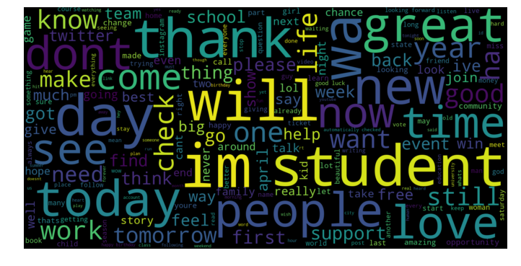
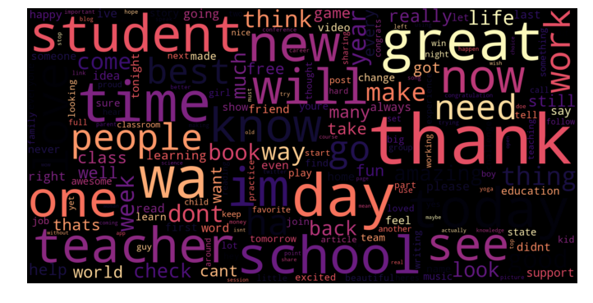
Feature Importance
Student WordCloud
Teacher WordCloud
Each word becomes a feature that helps the model predict class
Predictive Term Frequency Table
students teachers total
“school” 26 72 98
“best” 20 50 70
“teacher” 6 47 53
“book” 14 35 49
“class” 10 29 39

Slide 5
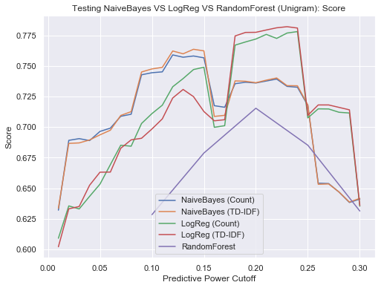
Vectorizers / Classifiers / Stopwords / Cross-Validation
CountVectorizer & TfidfVectorizer
MultinomialNB & LogisticRegression & RandomForestClassifier
Stopwords: Non-predictive features are based on a changing range of feature predictiveness from lowest predictiveness to a given cutoff

Slide 6
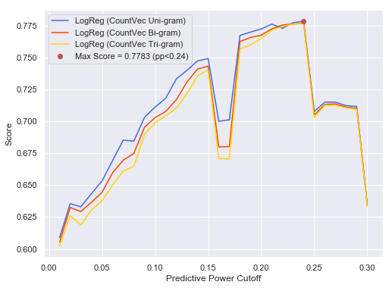
Results
Score by count/tf-idf vectorizer and uni/bi/tri_gram
NaiveBayes: count uni 0.7384 bi 0.7333 tri 0.7262
tf-idf uni 0.739 bi 0.7356 tri 0.7274
LogReg: count uni 0.7613 bi 0.7692 tri 0.7674
tf-idf uni 0.7696 bi 0.7689 tri 0.7667
(logreg-countvec-bigram has the highest score)
RandForest: count uni 0.7109 bi 0.7075 tri 0.7043
tf-idf uni 0.7151 bi 0.7128 tri 0.7079
(all scores above w/ custom_stop_words such that predictive_power < 0.2)

Slide 7
Reflection
Why does this problem matter? - The ability to identify individuals from the masses by a certain class, whether that is from Twitter or some other platform, is an extraordinarily tool to have for any data project.
How could this technology be used? - Being able to classify a group of people based on their tweets can be useful for advertising, but also for…
Filtering out spam
Identify abusive or obscene content
Group similar frequently asked questions to streamline response
Compare positive and negative user reviews for improvement
Identifying individuals that might pose a security threat
Links:
https://twitter.com/,
https://followerwonk.com/,
https://github.com/Jefferson-Henrique/GetOldTweets-python/blob/master/LICENSE

